Slide 1
Superintendent’s Redistricting Recommendations to School Board
February 14, 2012

Slide 2
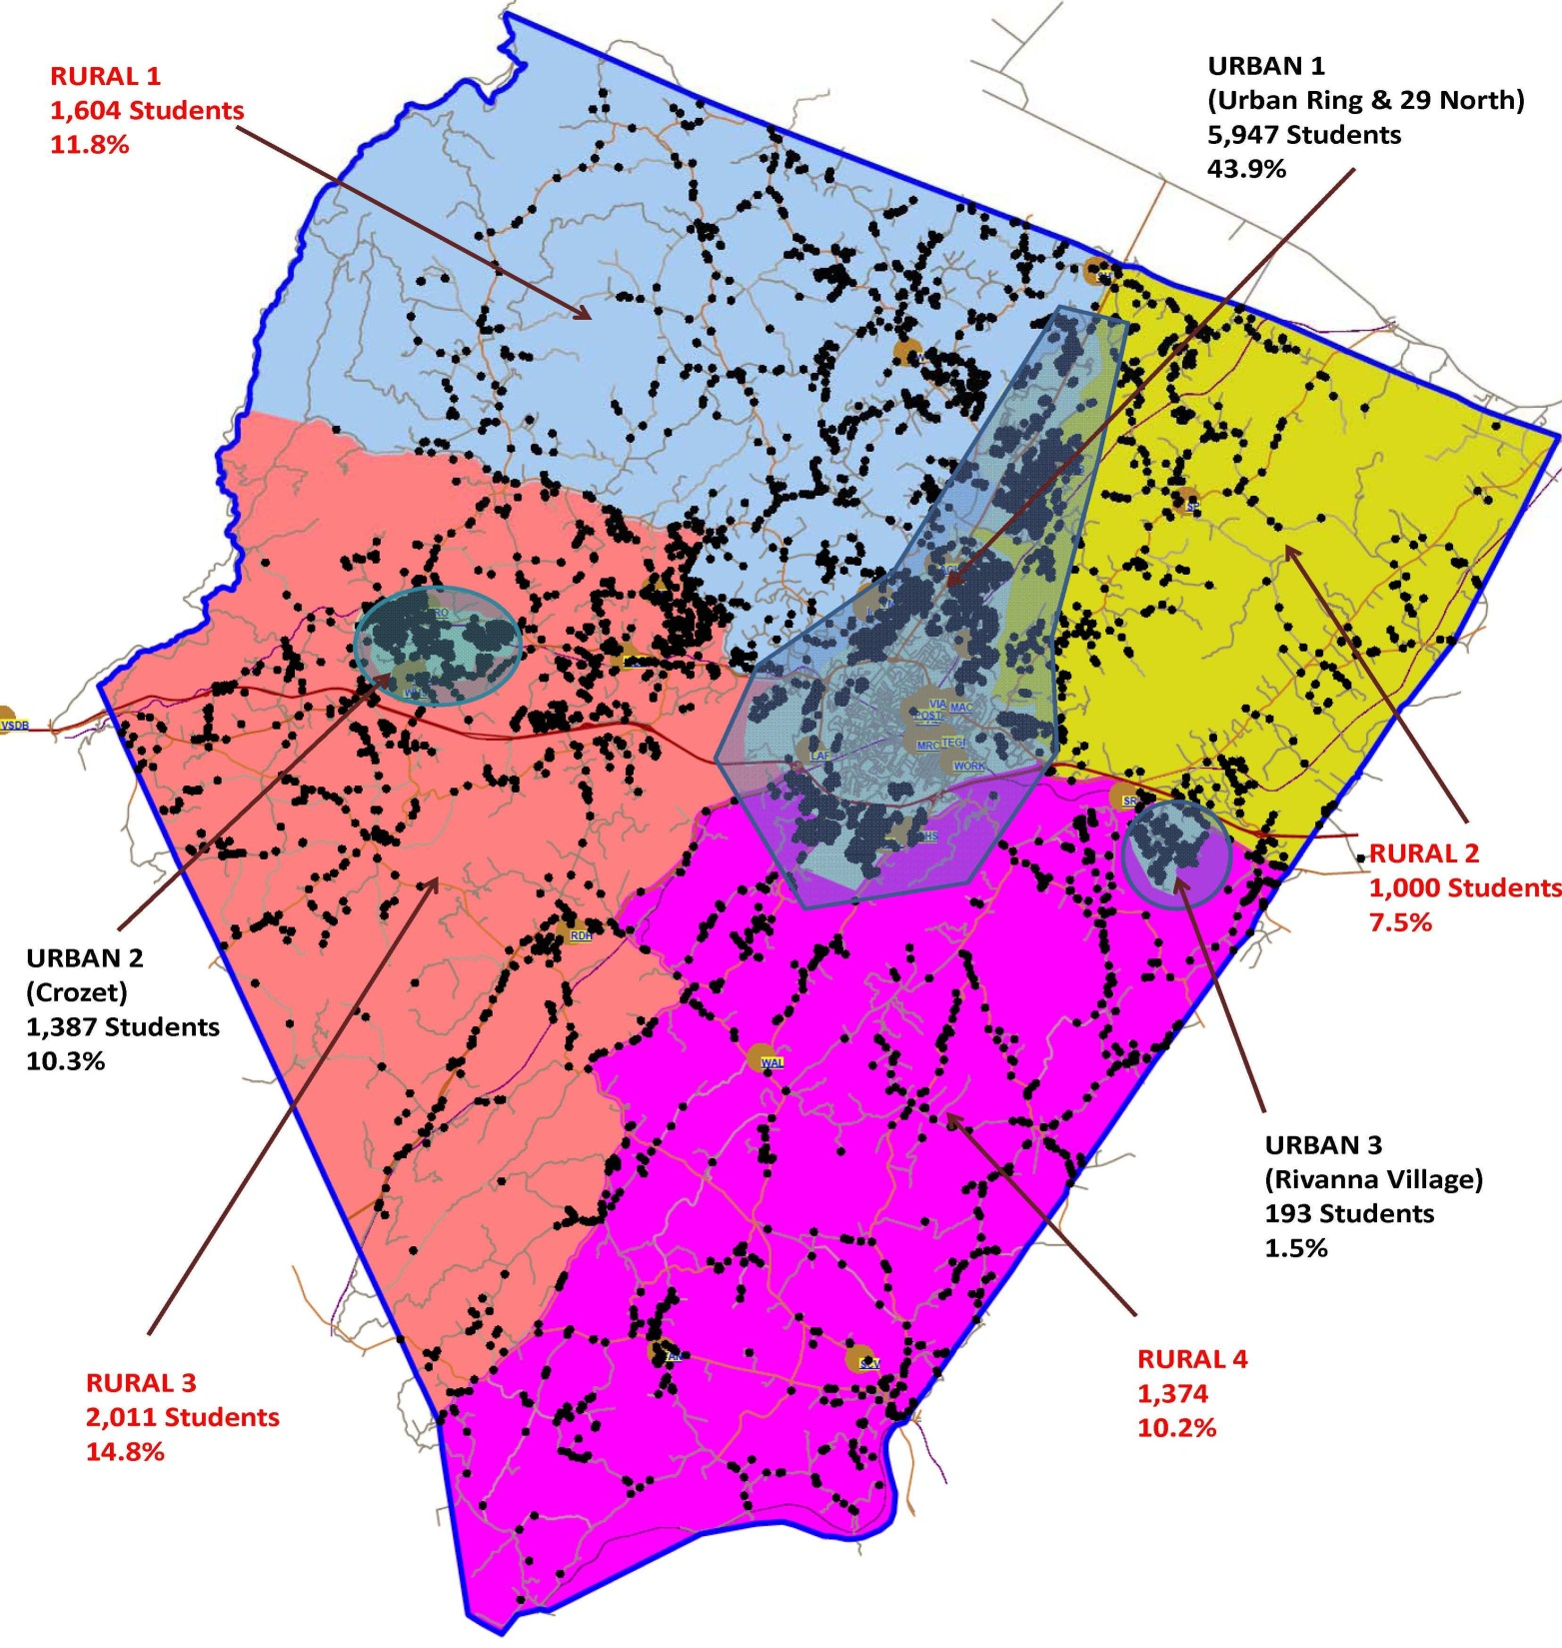
Student Distribution
44%
Rural
56%
Urban

Slide 3
Student Population by Region
2006 | 2013

Slide 4
Student Population by Region
2006 | 2013

Slide 5
Student Population by Region
 |  | 2006 | 2013 | Difference | % Change
Rural 1 | N-NW | 1,676 | 1,604 | -72 | -4%
Rural 2 | NE | 1,082 | 1,000 | -82 | -8%
Rural 3 | W-SW | 2,250 | 2,011 | -239 | -11%
Rural 4 | SE | 1,438 | 1,374 | -64 | -4%
Urban 1 | Urban Ring/29N | 5,320 | 5,947 | 627 | 12%
Urban 2 | Crozet | 934 | 1,387 | 453 | 49%
Urban 3 | Rivanna Village | 202 | 193 | -9 | -4%
TOTAL |  | 12,902 | 13,516 | 614 | 5%
Rural Total |  | 6,446 | 5,989 | -457 | -7%
Urban Total |  | 6,456 | 7,527 | 1,071 | 17%

Slide 6
School Board Direction
At its August 23, 2012 meeting,
the School Board directed Superintendent Pam Moran
to appoint an advisory committee
to address capacity issues at
Agnor-Hurt Elementary School and at elementary schools in the Western Feeder Pattern.

Slide 7
Redistricting Timeline
Oct – Nov 2012 | Regular Subcommittee Meetings COMPLETE
Dec 10, 2012 Dec 11, 2012 | Subcommittees conduct public meetings COMPLETE
Dec 2012 | Subcommittees reconvene to analyze public feedback COMPLETE
Jan 2013 | Subcommittees present final recommendations to the Superintendent COMPLETE
Feb 14, 2013 | Superintendent presents her recommendations to the School Board IN PROGRESS
Mar 14, 2013 | School Board conducts public hearing
Apr 2013 | Families will be notified of any changes to take effect
Apr – Aug 2013 | Transition activities

Slide 8
Agnor-Hurt Subcommittee

Slide 9
Committee Members
Amy Baugher, Andrea Mejia, David Moyer & Christopher Smith, Agnor-Hurt Elementary
Jane McBrian & Cushing Whitney,
Broadus Wood Elementary
Heather Swindler, Greer Elementary
Jim Tierney, Woodbrook Elementary
Anne Shipe, Long-Range Planning Advisory Committee
Gerald Terrell, Superintendent’s Appointee

Slide 10
Current Capacity vs. Enrollment
School | Building Capacity | Fall 2012 Enrollment | Capacity Conflict
Agnor-Hurt | 464 | 606 | (142)
Broadus Wood | 360 | 285 | 75
Greer | 542 | 468 | 74
Woodbrook | 312 | 299 | 13

Slide 11
Projected Capacity vs. Enrollment
School | Building Capacity | 5-Year Projected Enrollment & Capacity Conflicts
 |  | 2013-14 | 2014-15 | 2015-16 | 2016-17 | 2017-18
Agnor-Hurt | 464 | 642 | 656 | 678 | 689 | 687
 |  | (178) | (192) | (214) | (225) | (223)
Broadus Wood | 360 | 288 | 289 | 302 | 300 | 309
 |  | 72 | 71 | 58 | 60 | 51
Greer | 542 | 476 | 489 | 487 | 508 | 508
 |  | 66 | 53 | 55 | 34 | 34
Woodbrook | 312 | 294 | 296 | 302 | 306 | 306
 |  | 18 | 16 | 10 | 6 | 6

Slide 12
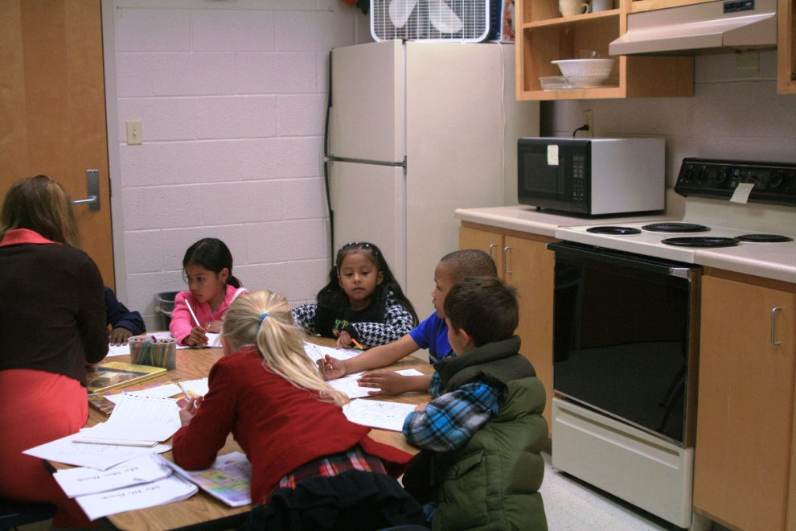
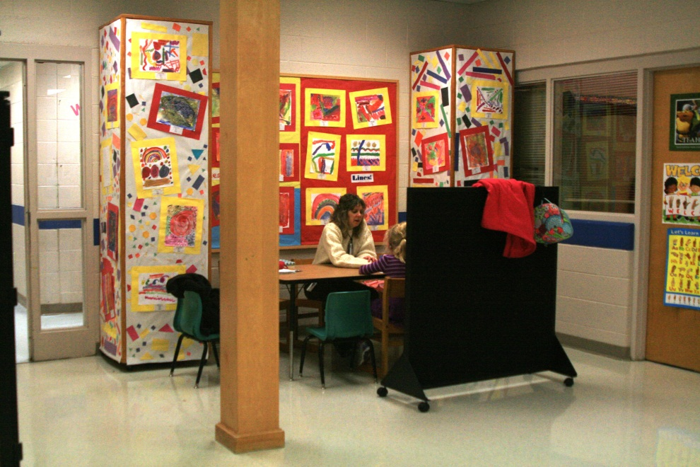
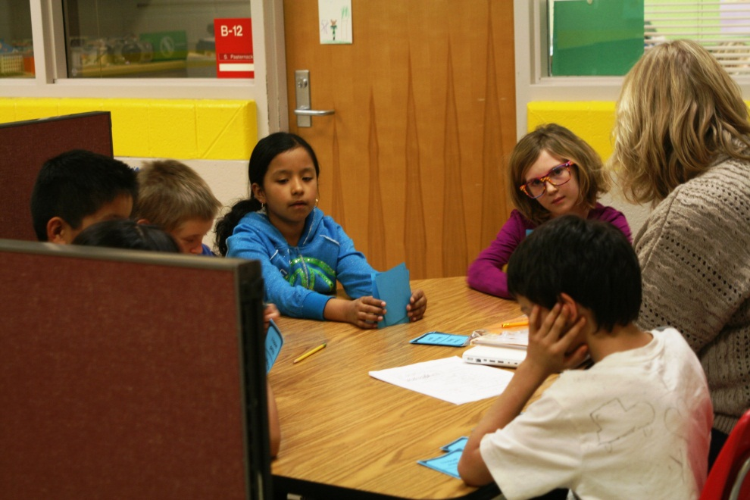
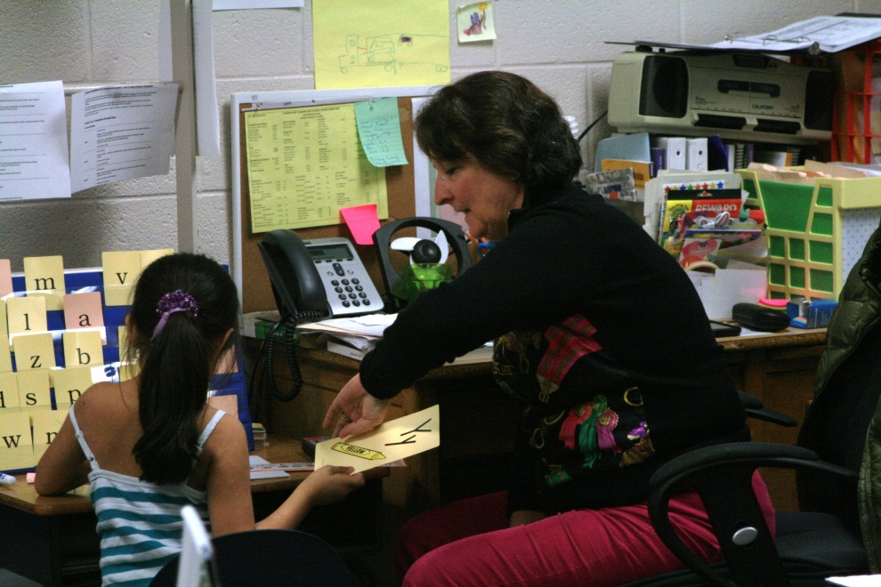
Makeshift Learning Spaces

Slide 13
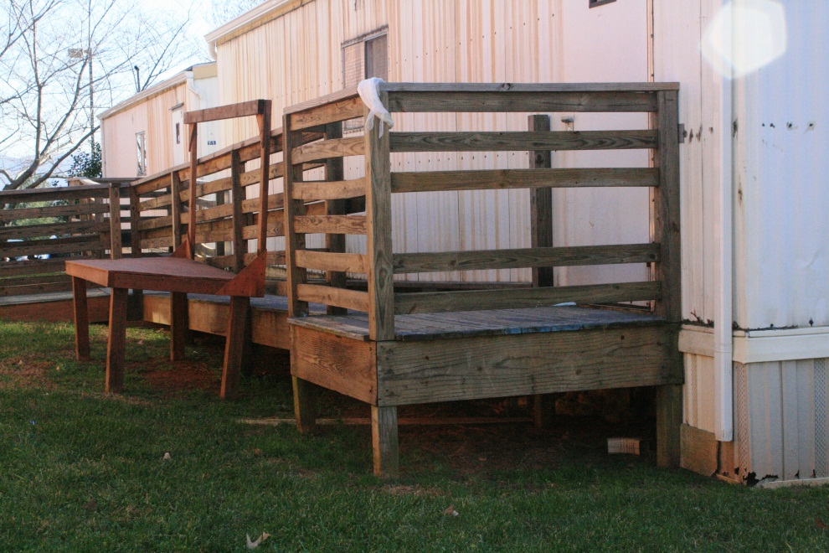
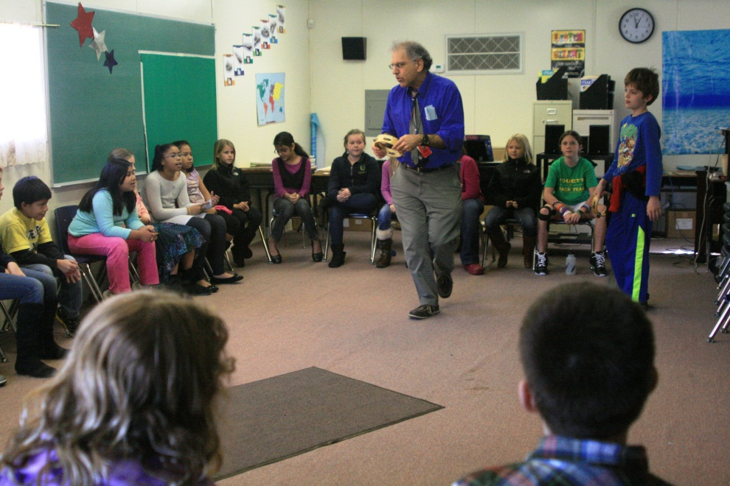
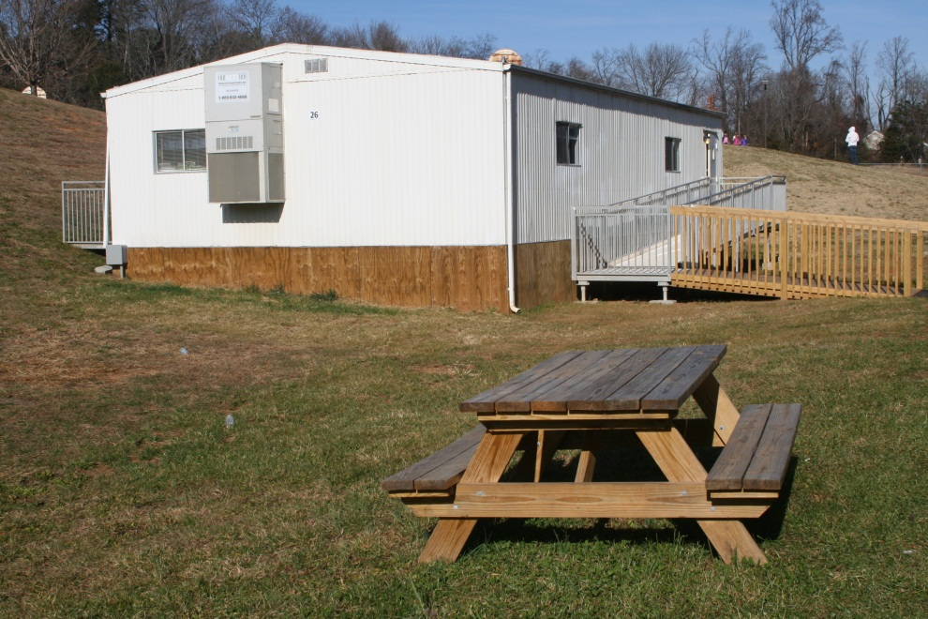
Agnor-Hurt Trailers
Trailer Usage:
Gifted Resources and ESOL Remediation
Music
Student Support Services

Slide 14
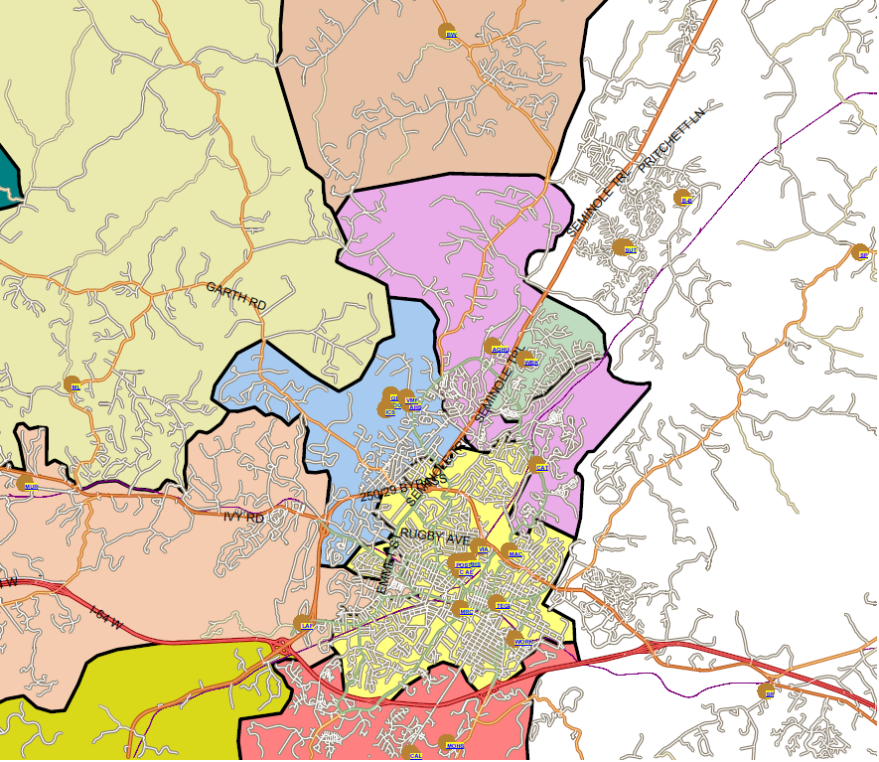
Current Elementary School Boundaries
Broadus Wood
Agnor-Hurt
Woodbrook
Greer

Slide 15
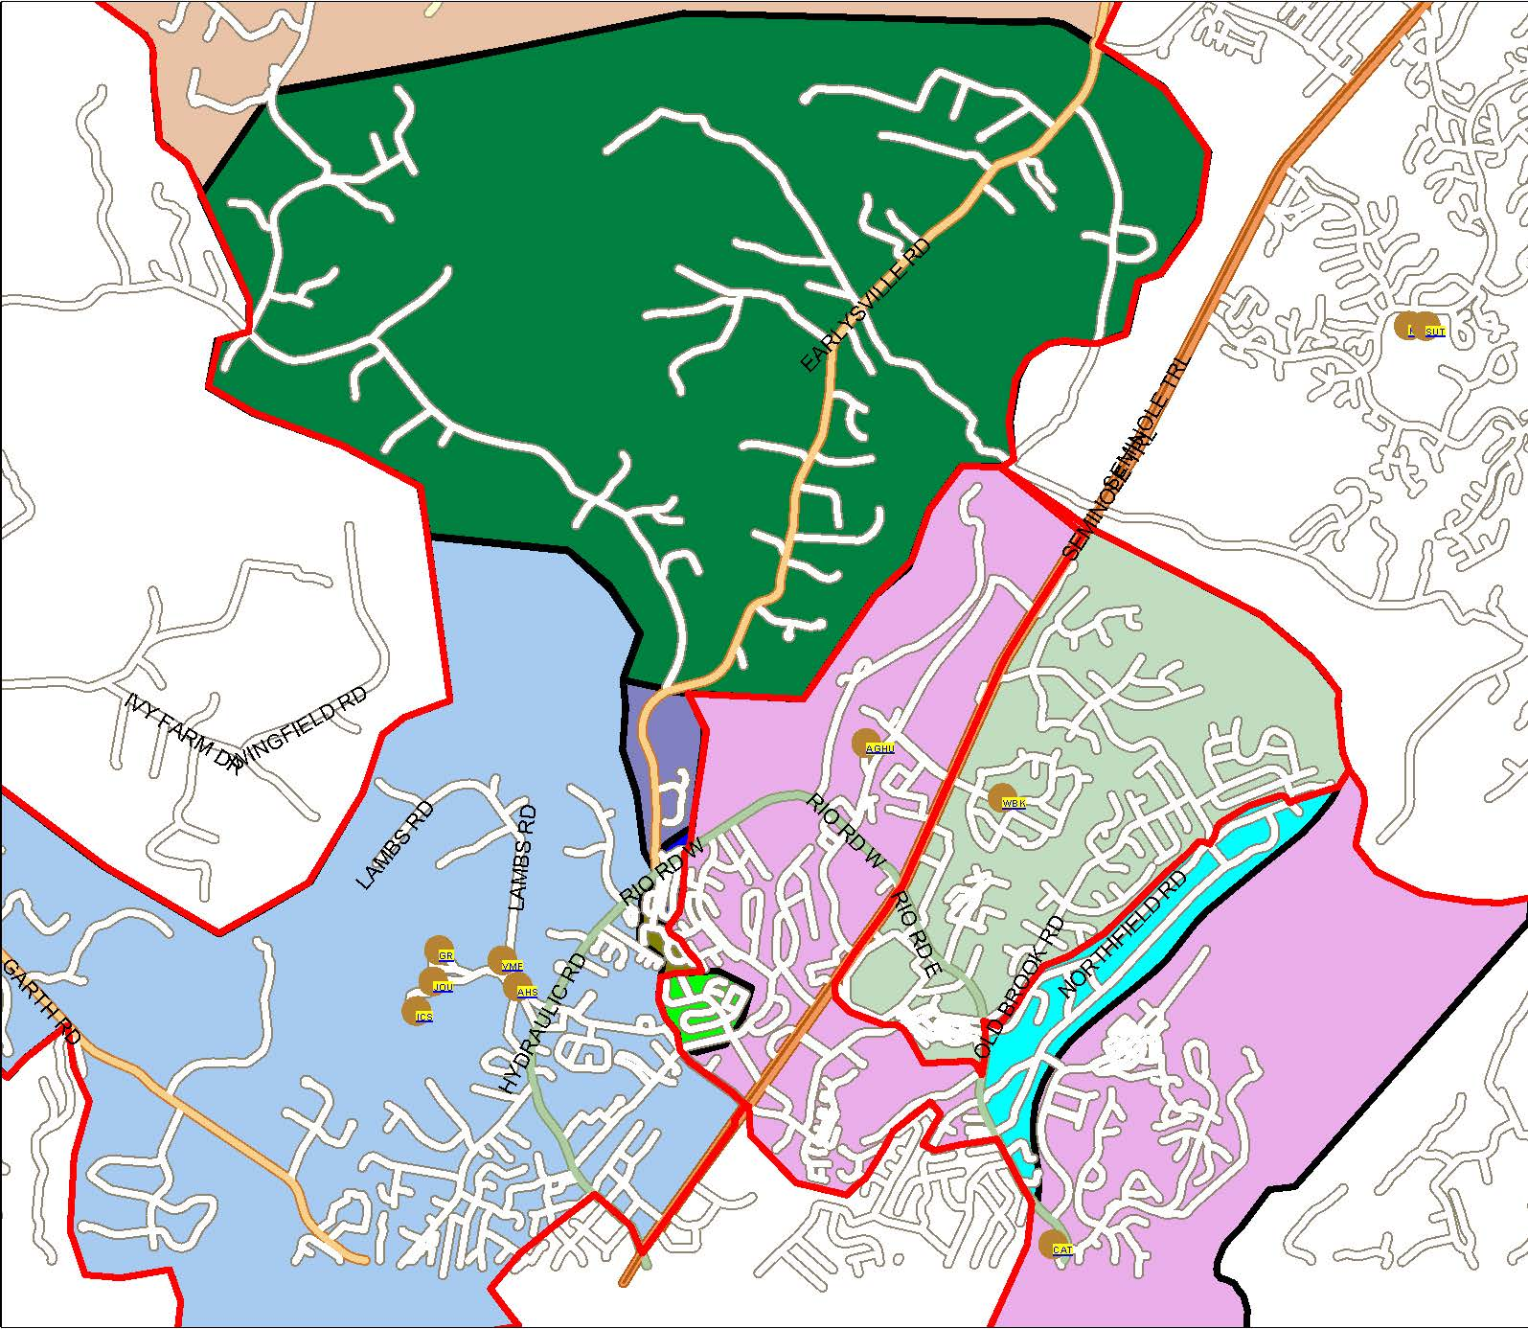
Proposed Areas of Movement
Woodlands/ Earlysville Rd
Northfield/ Huntington
Squirrel Ridge
Crenshaw/ Triangle Ct
Townwood
Minor Ridge

Slide 16
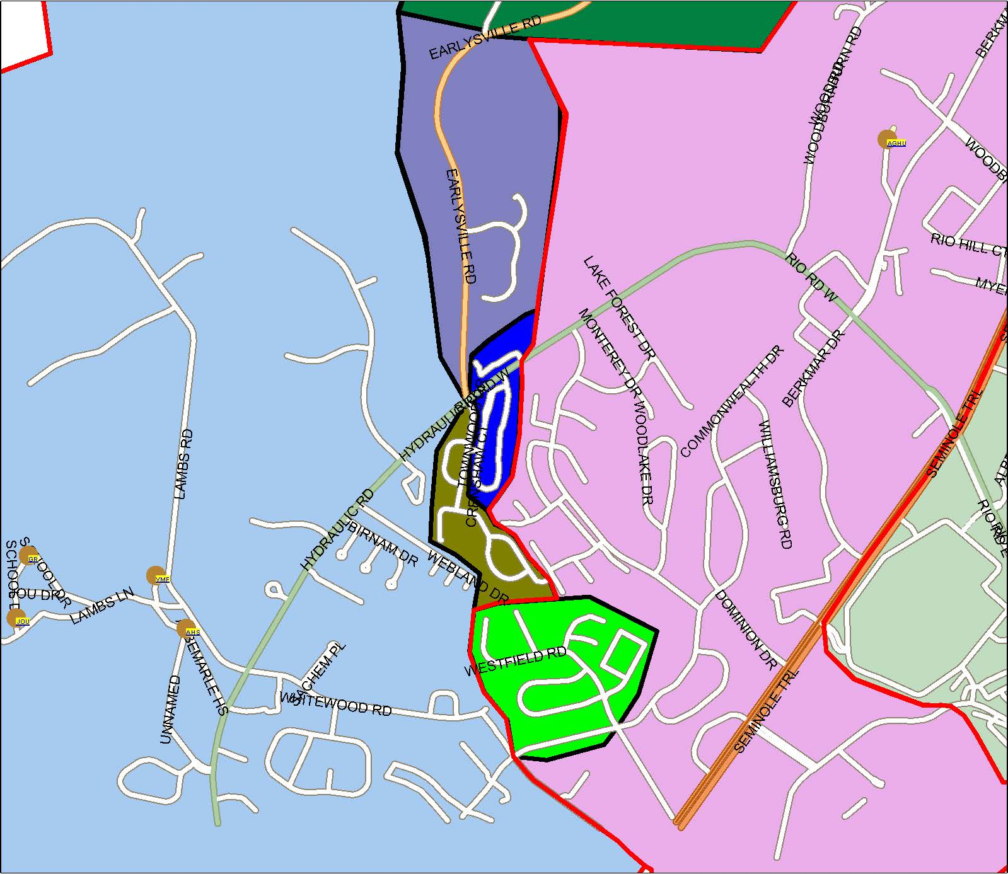
ZOOM: Proposed Areas of Movement to Greer
Squirrel Ridge
Crenshaw/ Triangle Ct
Townwood
Minor Ridge

Slide 17
Redistricting Option 1: 66 Students
Neighborhood | Affected Elementary Students (Pre-K – 5) | Proposed Elementary School | Affected Middle School Students (5-7) | Current Middle School | Proposed Middle School
Woodlands/ Earlysville Rd | 46 | Broadus Wood | — | Jouett | No change
Northfield/ Huntington | 20 | Woodbrook | 14 | Burley | Jouett
TOTAL | 66 |  | 14

Slide 18
Redistricting Option 2: 94 Students
Neighborhood | Affected Elementary Students (Pre-K – 5) | Proposed Elementary School | Affected Middle School Students (5-7) | Current Middle School | Proposed Middle School
Option 1 | 66 |  | 14
Squirrel Ridge | 2 | Greer | — | Jouett | No change
Townwood | 26 | Greer | — | Jouett | No change
Crenshaw/ Triangle Ct | — | No change | 30 | Jouett | Burley
TOTAL | 94 |  | 44
All Agnor-Hurt students could move on to Burley Middle School.

Slide 19
Redistricting Option 3: 107 Students
Neighborhood | Affected Elementary Students (Pre-K – 5) | Proposed Elementary School | Affected Middle School Students (5-7) | Current Middle School | Proposed Middle School
Option 1 | 66 |  | 14
Squirrel Ridge | 2 | Greer | — | Jouett | No change
Minor Ridge | 39 | Greer | 14 | Burley | Jouett
Townwood | — | No change | 11 | Jouett | Burley
Crenshaw/ Triangle Ct | — | No change | 30 | Jouett | Burley
TOTAL | 107 |  | 69
All Agnor-Hurt students could move on to Burley Middle School.

Slide 20
Ethnicity Key
AI = American Indian or Alaska Native
AS = Asian
BL = Black
HL = Hispanic/Latino
MR = Multiracial
WH = White

Slide 21
Ethnicity Shift at Agnor-Hurt

Slide 22
All Options: Ethnicity Shift at BWES & WES
Current State Redistricted State

Slide 23
Options 2 & 3: Ethnicity Shift at Greer

Slide 24
Effect on F/R Lunch Percentages

Slide 25
Shift in English Language Learners

Slide 26
Recommendations:
Agnor-Hurt Elementary School
Unanimous Recommendation of Committee
Woodlands/Earlysville Rd to Broadus Wood (46 students) + Northfield/Huntington to Woodbrook
(20 students) + Squirrel Ridge and Townwood to Greer (28 students) = 94 students.
Grandfather clause: All rising fifth-graders and their siblings are permitted to stay at Agnor-Hurt for one year only (2013-14), but they must provide their own transportation or use an existing Agnor-Hurt bus stop, if capacity allows.

Slide 27
Current Middle School Boundaries
Woodlands/ Earlysville Rd
Jouett
Burley
Northfield/ Huntington
Squirrel Ridge
Jouett
Crenshaw/ Triangle Ct
Townwood
Minor Ridge
Burley

Slide 28
Enrollment Shift at Burley & Jouett
 | Burley: 566 Students |  |  | Jouett: 580 Students
Neighborhood | Opt. 1 | Opt. 2 | Opt. 3 | Opt. 1 | Opt. 2 | Opt. 3
Northfield/ Huntington | (14) | (14) | (14) | +14 | +14 | +14
Crenshaw/ Triangle Ct | — | +30 | +30 | — | (30) | (30)
Minor Ridge | — | — | (14) | — | — | +14
Townwood | — | — | +11 | — | — | (11)
Net Shift* | (14) | +16 | +13 | +14 | (16) | (13)
*Based on current enrollment in grades 5-7

Slide 29
Recommendations:
Middle School Districting
Unanimous Subcommittee Recommendations:
Redistrict Northfield/Huntington to Jouett in order to prevent a new split feeder pattern at Woodbrook.
Grandfather clause: All rising seventh- and eighth-graders are permitted to stay at Burley until they complete middle school, but they must provide their own transportation or use an existing Burley bus stop, if capacity allows.
Contested Recommendation (Passed 9-1):
Crenshaw/Triangle Ct. remain at Jouett, which maintains status quo and addresses public feedback.

Slide 30
Back-Up Slides

Slide 31
Ethnicity Across Schools
606 Students
285 Students
468 Students
299 Students

Slide 32
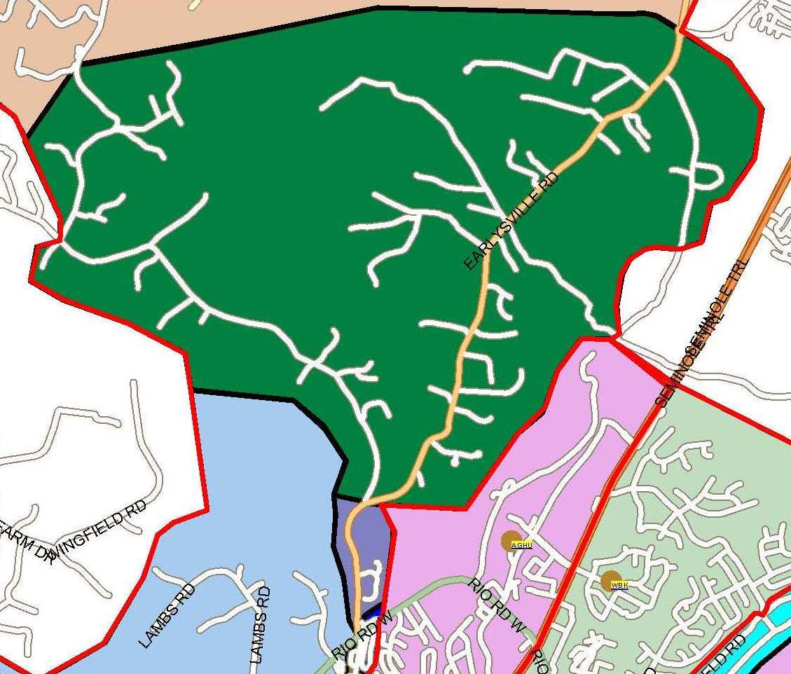
Woodlands/Earlysville Rd. to Broadus Wood
Notes:
Predominantly STABLE Neighborhood
1 Pre-K Student
No African American Students

Slide 33
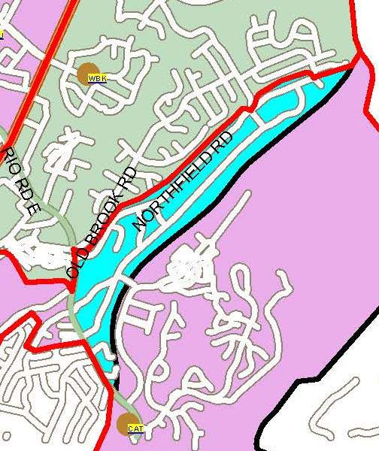
Northfield/Huntington to Woodbrook
Notes:
Predominantly STABLE Neighborhood
No Pre-K Students
No 3rd Graders
No Asian Students
No African American Students

Slide 34
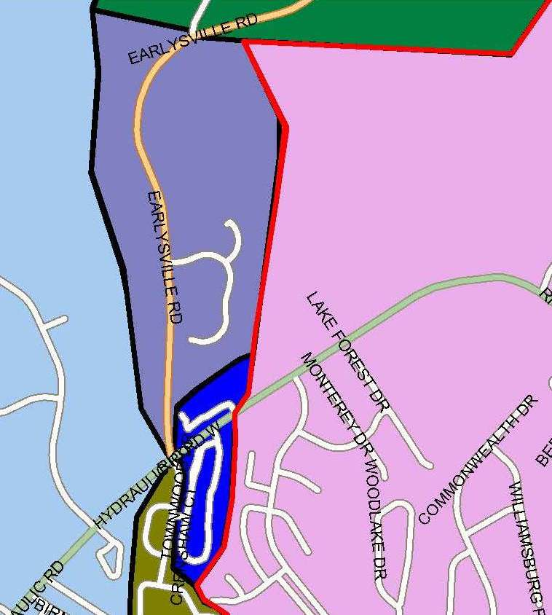
Squirrel Ridge to Greer
Notes:
Predominantly STABLE Neighborhood
2 Students, both 4th Graders
100% Caucasian

Slide 35
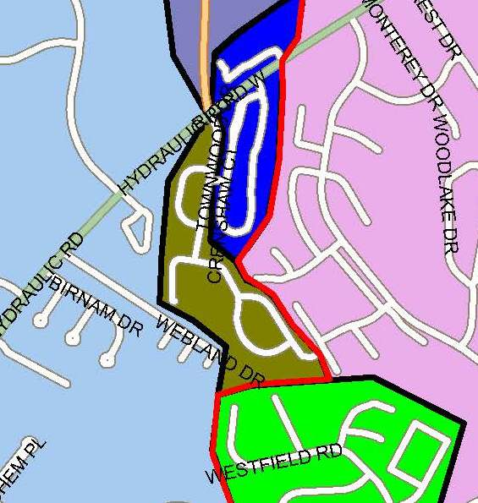
Townwood to Greer
Notes:
Predominantly STABLE Neighborhood
1 Pre-K Student
No Asian Students
No Multiracial Students

Slide 36
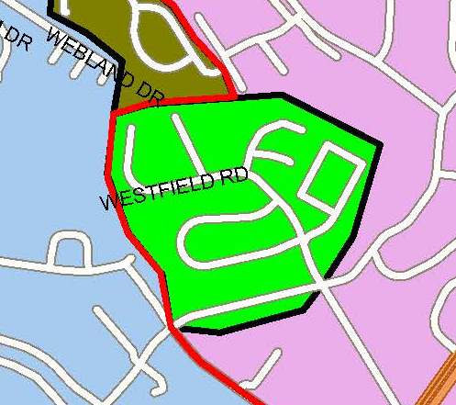
Minor Ridge to Greer
Notes:
Predominantly STABLE Neighborhood
2 Pre-K Students
No Asian Students

Slide 37
Western Feeder Pattern Outline
Considerations & Recommendation: Meriwether Lewis
Considerations & Recommendation:
Crozet Addition
Considerations & Finding: Red Hill

Slide 38
Committee Members
Kelly Gobble & Gavin MacCleery, Brownsville Elementary
Jeffrey House & Craig Lindqvist, Crozet Elementary
Holly Bittle & James Younger, Meriwether Lewis Elementary
Kate Batkich & Mary Margaret Frank, Murray Elementary
Patrick Barnett, Red Hill Elementary
Keith Hammon, At-Large Appointee
Tiffany Barber, Long-Range Planning Advisory Committee
Andrea Roberts, Superintendent’s Appointee

Slide 39
MLES: Capacity vs. Enrollment
(LRPAC Report, July 2012)
Meriwether Lewis | Building Capacity | Enrollment | Capacity Conflict | # of Trailers
2011 (Actual) | 380 | 446 | (66) | 3
2012 (Projected) | 380 | 462 | (82) | 3

Slide 40
Current Capacity vs. Enrollment
School | Building Capacity | Fall 2012 Enrollment | Capacity Conflict | # of Trailers
Brownsville | 756 | 707 | 49 | 0
Crozet | 342 | 316 | 26 | 0
Meriwether Lewis | 380 | 432 | (52) | 4
Murray | 316 | 272 | 44 | 1
Red Hill | 160 | 168 | (8) | 4

Slide 41
Current Capacity vs. Enrollment
(with no computer room exclusion)
School | Building Capacity | Fall 2012 Enrollment | Capacity Conflict | # of Trailers
Brownsville | 756 | 707 | 49 | 0
Crozet | 342 | 316 | 26 | 0
Meriwether Lewis | 400 | 432 | (32) | 4
Murray | 316 | 272 | 44 | 1
Red Hill | 160 | 168 | (8) | 4

Slide 42
Projected Capacity vs. Enrollment
School | Building Capacity | 5-Year Projected Enrollment & Capacity Conflicts |  |  |  |  | # of Trailers
 |  | 2013-14 | 2014-15 | 2015-16 | 2016-17 | 2017-18
Brownsville | 756 | 738 | 761 | 767 | 764 | 788 | 0
 |  | 18 | (5) | (11) | (8) | (32)
Crozet | 342 | 325 | 333 | 345 | 350 | 368 | 0
 |  | 17 | 9 | (3) | (8) | (26)
Meriwether Lewis | 380 | 438 | 442 | 455 | 458 | 452 | 4
 |  | (58) | (62) | (75) | (78) | (72)
Murray | 316 | 270 | 268 | 266 | 269 | 271 | 1
 |  | 46 | 48 | 50 | 47 | 45
Red Hill | 160 | 165 | 174 | 172 | 174 | 173 | 4
 |  | (5) | (14) | (12) | (14) | (13)

Slide 43
General Redistricting Options
GENERAL OPTION 1
Keep Meriwether Lewis district in a
holding pattern—no redistricting now
GENERAL OPTION 2
Redistrict any combination of up to 55 students to Murray and/or Crozet

Slide 44
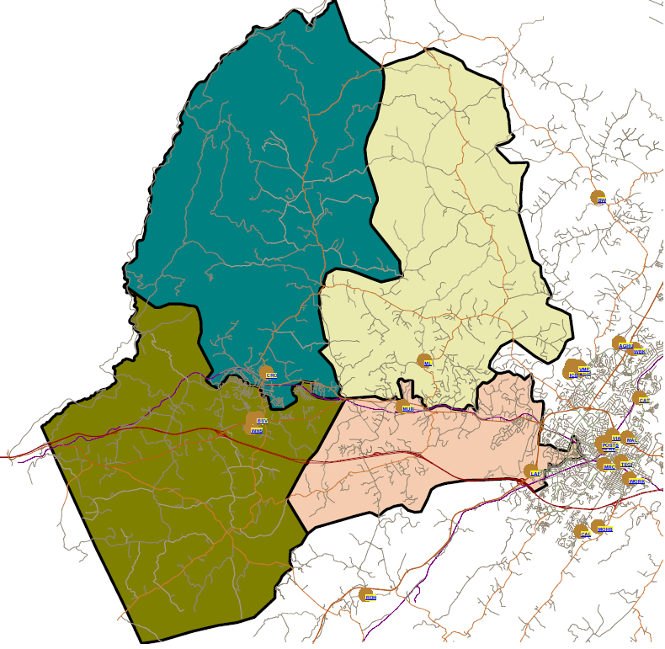
Western Feeder Pattern
Elementary School Boundaries
Crozet
Meriwether Lewis
Murray
Brownsville
Red Hill

Slide 45
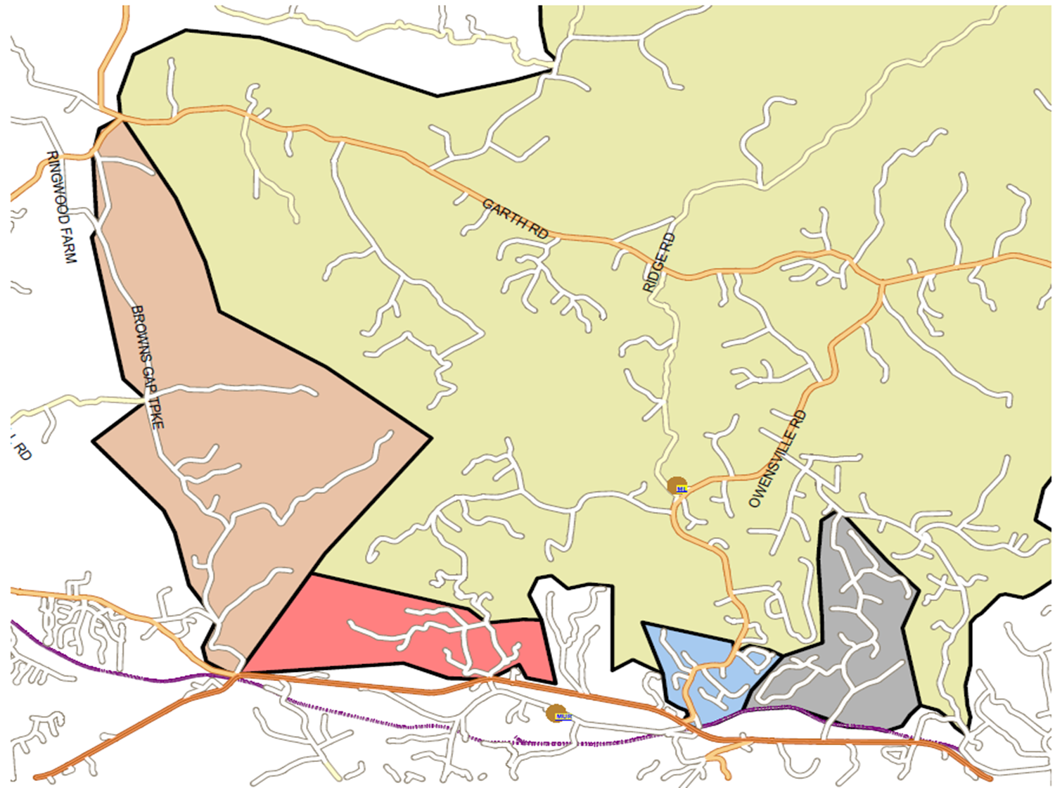
Option 2 - Proposed Areas of Movement
Browns Gap Tpk to Crozet
(2.29 mi closer to Crozet):
19 students
MERIWETHER LEWIS DISTRICT
West Leigh
to Murray
(0.83 mi closer to Meriwether):
28 students
Glenaire
to Murray
(2.08 mi closer to Murray):
8 students
Owensville/ Kimbrough
to Murray
(0.26 mi closer to Murray):
21 students

Slide 46
Recommendation: Meriwether Lewis
Unanimous Subcommittee Recommendation:
At this time, there is no clear benefit to moving students from Meriwether Lewis to other schools. The recommendation is to not redistrict at this time. The clear benefit of not redistricting is to maintain the flexibility of the enrollment in the feeder pattern.
Committee recommended considerations for the future:
Effective use of the existing space, including time table for removing trailers
Ongoing process/retention of a committee; continuous evaluation of program capacity at the four elementary schools
Monitoring enrollment data trends
Proposed redistricting to Crozet

Slide 47
Crozet Addition
The School Board has requested funding of an addition to Crozet Elementary to increase elementary school capacity for the Western Feeder Pattern for the school year 2016-17.
Is it feasible to redistrict students among the Western Feeder Pattern elementary schools to balance enrollment and capacity at that time?
Given uncertainty of enrollment projections, are there other considerations for elementary school capacity for further study by the School Board and LRPAC?

Slide 48
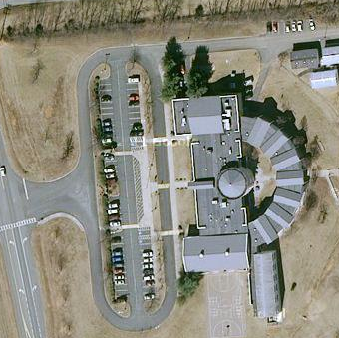
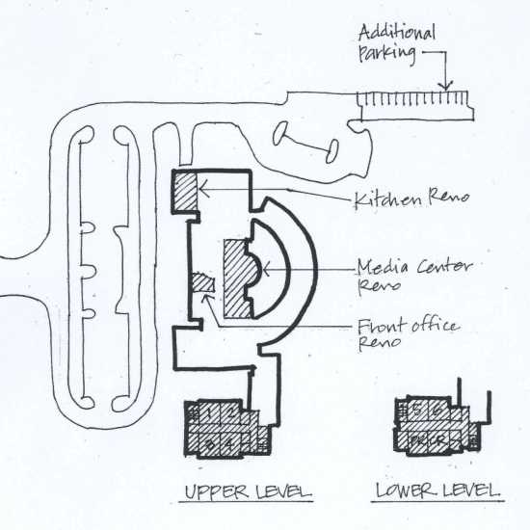
Crozet Addition & Renovation
Project Summary:
Total Cost: $5.67 M
Operational Year: 2016-17
Seats Added: 130
New Capacity: 472
Proposed Addition & Renovation:
15,535 SF Addition: 6 K-5 classrooms,
1 pre-K classroom, and 3 resource classrooms
Renovation of Media Center, kitchen, stage,
cafeteria ramp, and front office
Site improvements
A larger addition is feasible.

Slide 49
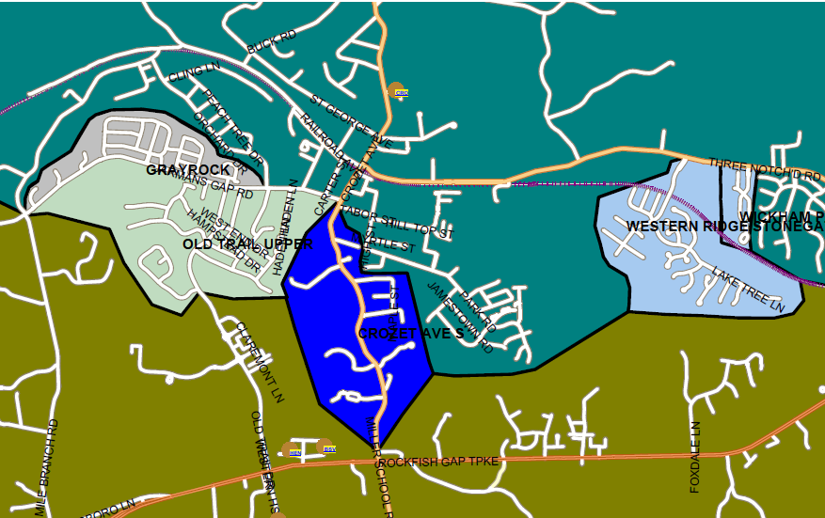
Brownsville to Crozet
Crozet
Brownsville

Slide 50
Summary: Brownsville to Crozet
Neighborhood | # of Students
Wickham Pond & Western Ridge | 125
Grayrock, Waylands, Bargamin | 124
Old Trail Upper | 117
Crozet Ave South | 15
TOTAL STUDENTS = 381

Slide 51
Recommendation: Crozet Addition
Unanimous Subcommittee Recommendations:
Revisit the CIP request for Crozet in terms of the new data for enrollment projections, the size of the proposed addition, and patterns of growth in the Western Feeder Pattern.
Emphasize the priority of the ranking of the Crozet addition. Adding capacity to the school/feeder pattern is a high priority.
Consider more options for the Crozet addition.
Affirm the belief that Crozet is the best school in the feeder pattern for an addition.
School additions should be prioritized for the designated growth area.
Explore financing options for the additions.

Slide 52
Red Hill Expansion
The School Board has requested feedback on the following concept: A significant expansion at Red Hill Elementary has not been requested by the School Board. Such an expansion could provide increased capacity and allow portions of the Western Feeder Pattern to be shifted to the Southern Feeder Pattern (Red Hill/Walton or Burley/Monticello).
Is it feasible to redistrict students to balance enrollment and capacity among the feeder patterns at the elementary, middle and high school levels?
If this scenario is feasible, should the School Board continue to study the concept?

Slide 53
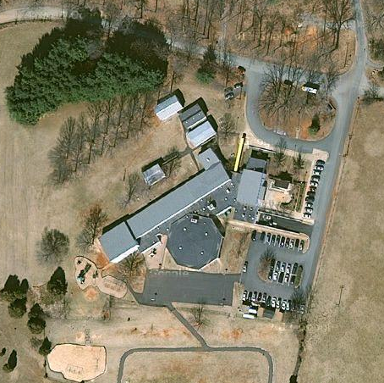
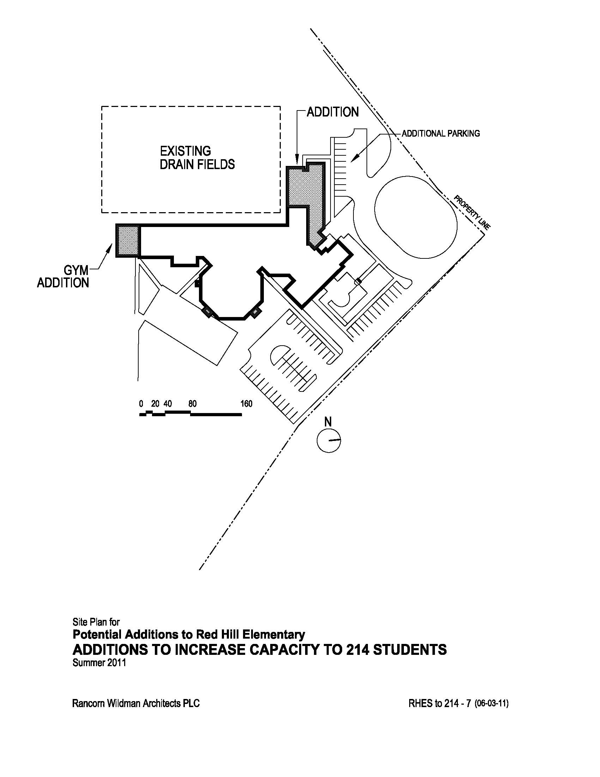
Red Hill Modernization
Project Summary
Total Cost: $5.61 M
Operational Year: 2017-18
Seats Added: 36
New Capacity: 196
Proposed Addition & Renovation:
5,500 SF Addition: Art classroom, Music
classroom, Toilets for existing K-1 rooms,
Expanded Media Center, Expanded Gym,
and new admin area & vestibule
Renovation of existing classrooms and existing
toilets; new furniture throughout the building

Slide 54
Summary: Brownville/Murray to Red Hill
Neighborhood | Elem School Students | Middle School Students | High School Students | Total # of Students
Plank Rd/Craigs Store | 38 | 8 | 17 | 63
Dick Woods Rd South of I-64 | 37 | 23 | 23 | 83
29 Bypass | 22 | 12 | 19 | 53
TOTAL | 97 | 43 | 59 | 199

Slide 55
Finding: Red Hill
Unanimous Subcommittee Recommendations:
The Red Hill modernization should take place for parity to serve students in current feeder pattern/existing students.
Do not support the movement of students across current feeder patterns.
Maintain the sense of community.
The current enrollment projections do not demonstrate a large enough number of students to be moved to provide a clear benefit to students.
School additions should be prioritized for the designated growth area

Slide 56
Backup Slides

Slide 57
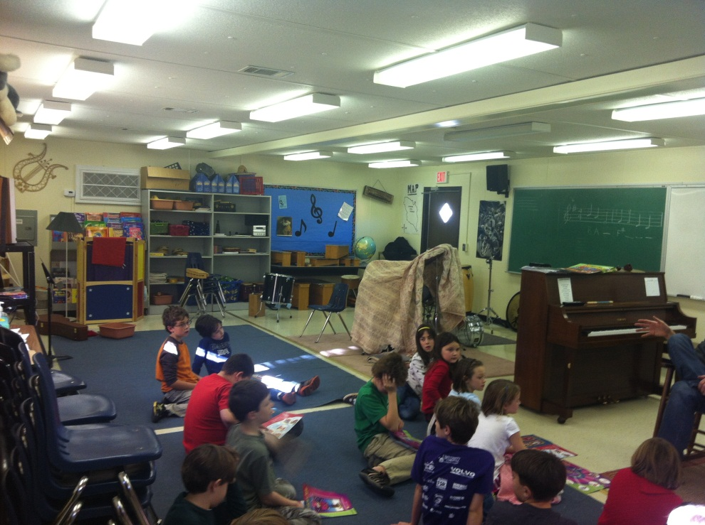
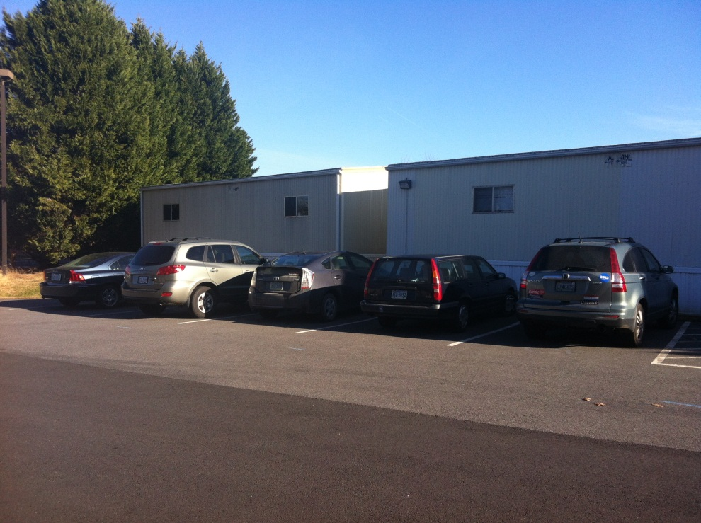
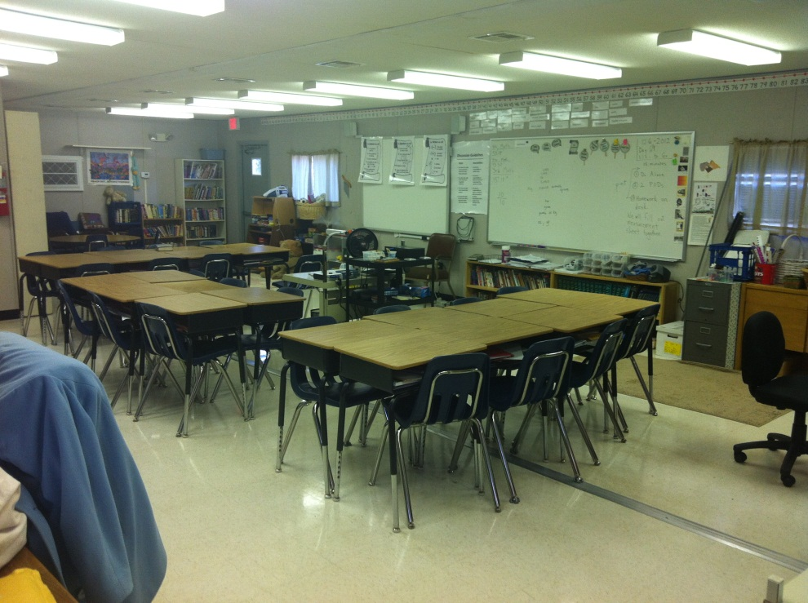
Trailer Usage:
Music
Gifted Resource
Special Education
Special Education Resource

Slide 58
Henley and Western Albemarle CIP Requests
Henley:
Phase 1 – Auxiliary Gym, $2.3M; complete 2016-17
Phase 2 – Media Center, $0.9M; complete 2017-18
Phase 3 – Forum, $1.8M; complete 2018-19
Western Albemarle:
Kitchen Upgrades, $0.3M; complete 2016-17
Modernization, $1.9M; complete 2018-19
Addition, $8.6M; complete 2020-21

Slide 59
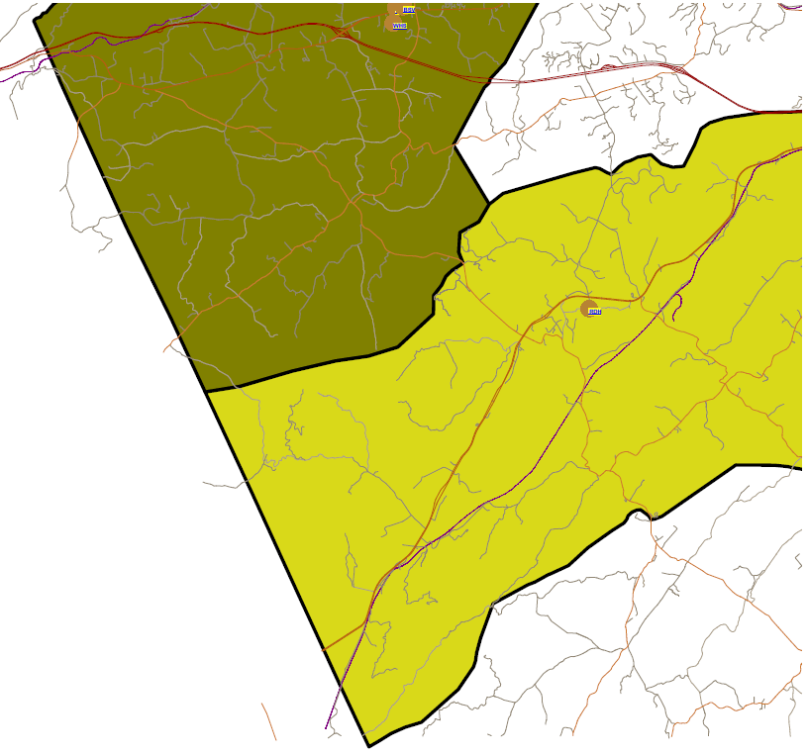
From Brownsville/Henley/WAHS to Red Hill/Walton/MoHS
BROWNSVILLE
Batesville
Craigs Store Rd
Plank Rd
RED HILL
Spring Valley Rd
US Rt 29 South
Heards Mtn Rd

Slide 60
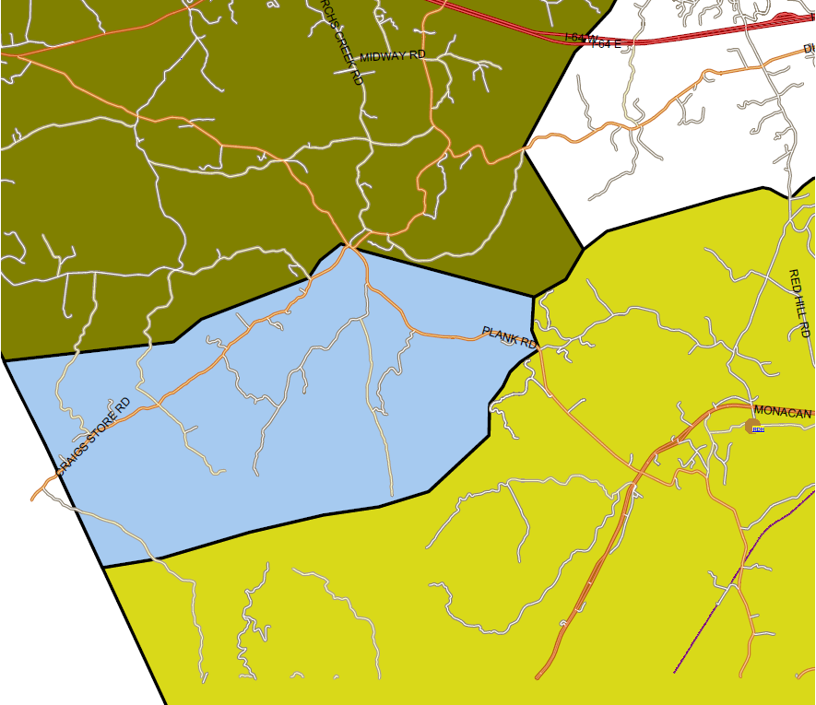
Plank Rd/Craigs Store
63 Students: 38 Elem, 8 Middle & 17 High
BROWNSVILLE
Miller School Rd
Batesville
RED HILL
PROPOSED AREA
Spring Valley Rd
US Rt 29 South

Slide 61
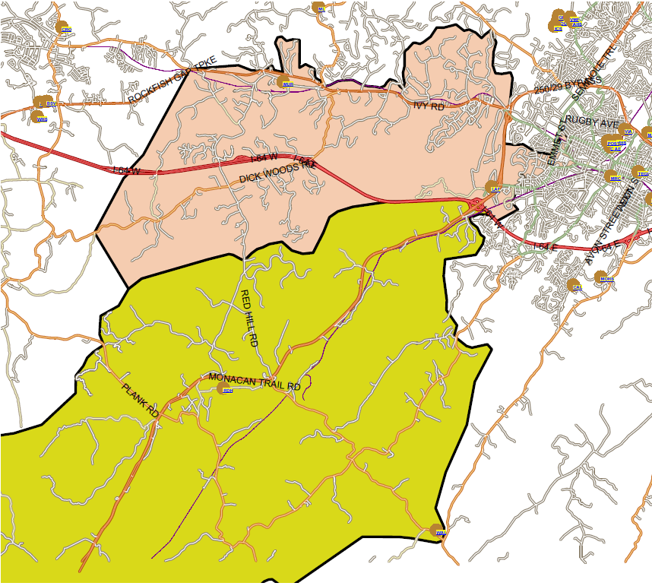
From Murray/Henley/WAHS to Red Hill/Walton or Burley/MoHS
MURRAY
RED HILL

Slide 62
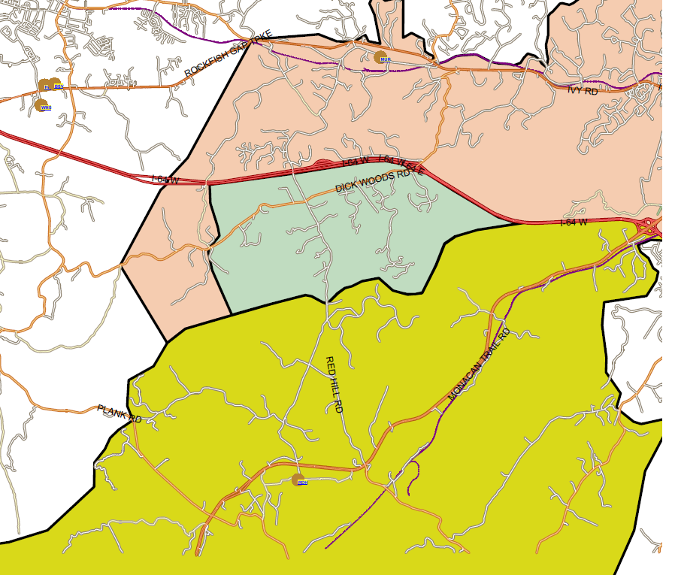
Dick Woods Rd South of I-64
83 Students: 37 Elem, 23 Middle & 23 High
MURRAY
The Rocks
PROPOSED AREA
Rosemont
Taylors Gap
RED HILL

Slide 63
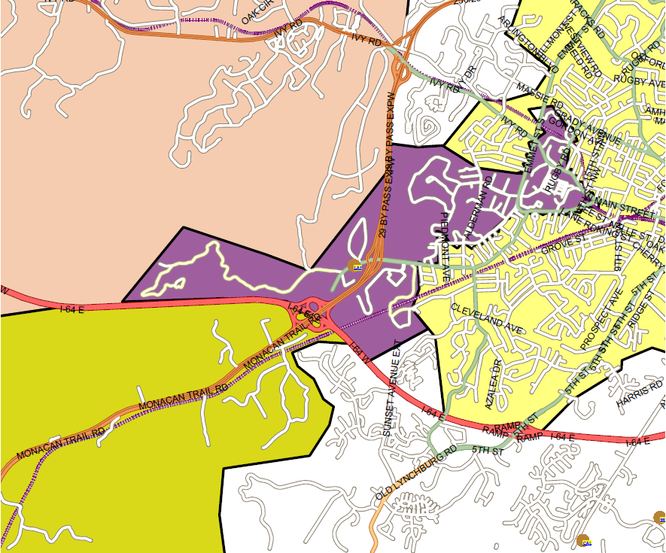
29 Bypass
53 Students: 22 Elem, 12 Middle & 19 High
MURRAY
Buckingham Cir
University Housing
PROPOSED AREA
RED HILL
Nob Hill Cir

